Slide 1
StegAnalysis 1399/12/24
Instructor:
Behnoud shafizadeh

Slide 2

Steganography and Steganalysis ecosystem
In summary:
Steganogeraphy : process for hiding data in different context(image,audio,…)
In contrast,
Steg Analysis : process for extracting data in different context(image,audio,…)

Slide 3
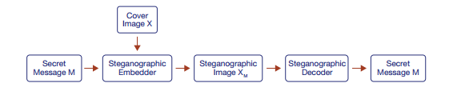
Steganography Ecosystem
Steganogeraphy :
Embedding
Transmission
Decoding

Slide 4
Purpose and various groups
In steganography, the steganographic embedder aims to minimize the difference between X and XM.
Steganographic embedders can be categorized as one of three types:
frequency
spatial
deep learning

Slide 5
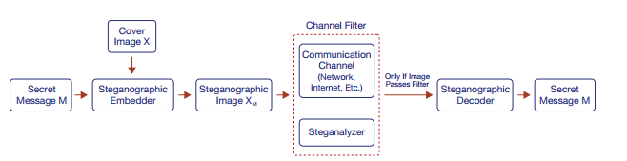
Steganalysis Ecosystem
Steganalysis is the process of detecting if a file contains steganographic content. steganalyzers could be used in real-world scenarios to block the transmission of steganographic content.
Steganalyser divided in two groups:
statistical techniques
deep learning methods
Deep learning models have a better performance rather than statistical models

Slide 6
Different types of steganalysis
There are two types:
Discriminate
only detect a subset of steganographic embedders.
Universal
detecting all known and unknown steganographic embedders
HINT:our purpose is developing Universl type,for having better performance

Slide 7
Problem Definition and Challenges
Critical problems in constructing ,practical and universal deep learning steganalysis:
Training and Execution Efficiency Problem : Most steganalyzers are computationally expensive to train and execute .Practical steganalyzers should be computationally efficient so they can be effectively deployed in applications.
Image Size Mismatch Problem Detection - Most steganalyzers can only detect images of a certain size. Furthermore, even those that can detect images of varying sizes tend to be less accurate .Practical steganalyzers must be effective at detecting images of all sizes.
Source Mismatch Problem - Steganalyzers commonly fail to detect steganographic images generated from a dataset the model has not been trained on . Steganalyzers should be able to detect steganographic images regardless of the source dataset.
Steganographic Embedder Mismatch Problem - Most steganalyzers are discriminate steganalyzers and can only detect steganographic embedders they are trained on . Steganalyzers must be able to detect unseen steganographic embedders to effectively mitigate steganography-enabled threat models.
Low Embedding Ratio Problem - Steganographic content is difficult to detect at low embedding ratios, making universal steganalysis increasingly challenging . To neutralize steganography-enabled threat models, steganalyzers must be able to detect low embedding ratios effectively.
Practical and Robust Evaluation Problem - Current research only evaluates steganalysis in a limited context (i.e. steganalyzers are only tested on certain image datasets).Steganalyzers must be evaluated in a diverse context to ensure that they are robust and effective in real-world situations.

Slide 8
Contributions
Practical Steganalysis Architectures - We design architecture, which enable image size mismatch problem detection and training and execution efficiency, respectively.
Robust Training Methodologies - We propose robust training methods that help create more universal steganalyzers. These methods include data augmentation techniques that also help overcome our novel adversarial attack system, StegAttack.
Robust Steganalysis Evaluation System - We develop a Python library, that enables comprehensive evaluation of steganalysis.
Comprehensive Evaluation of Deep Learning Steganalyzers - We comprehensively evaluate state-of-the-art deep learning steganalyzers to discover common failure modes and identify effective techniques.

Slide 9
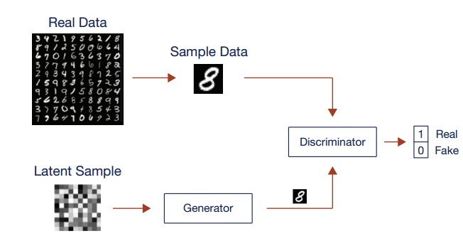
Back ground and related works
Deep learning overview:
deep learning is defined as a class of machine learning algorithms that use multi-layered neural networks to extract higher-level features from raw data . These methods use large amounts of training data to extract complicated, feature rich data for either generative or classification tasks .
Generative Adversarial Network
Divided by two components:
Generator
discriminator

Slide 10
About gan models
Generative adversarial networks (GANs) are deep learning architectures that are composed of a generator and a discriminator. The generator learns how to transform random noise into a target distribution, while the discriminator attempts to identify if the generated images are fake or real. This adversarial setup allows the generator to effectively model target distributions.
Notice: GAN systems are increasingly used in steganography since they are excellent at generating hard-to-detect steganographic images

Slide 11
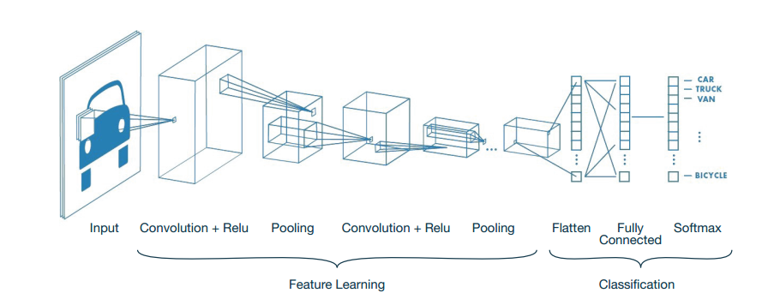
Classification models(Convolutional Neural Network )
Convolutional neural networks (CNNs) are deep learning architectures that use convolutional layers and sub-sampling layers to extract and classify meaningful signals from image data.
Hint: CNNs are used extensively in steganalysis for their ability to learn important features relevant to detecting steganographic images .

Slide 12
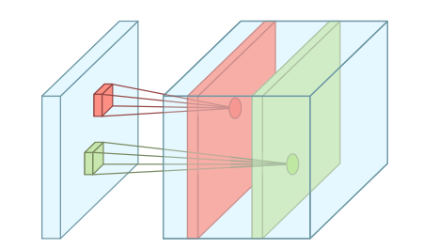
Components of CNN
Convolution layer
Convolutional layers extract spatially relevant data by convolving weights with input data. Convolutions are defined by their kernel size, stride, and padding. These parameters affect the types of spatial features the convolution can extract.

Slide 13
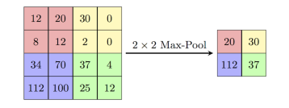
Components of CNN
Polling layer
Pooling layers down-sample input data by applying a function on subregions. For example, max pooling applies a max function to extract the strongest sub-region signals. Pooling is effective at reducing noise and extracting larger features.

Slide 14

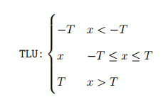
Components of CNN
Activation unit
The activation unit aids in the non-linear decision making of the system by allowing certain inputs to be sent forward.
Even though ReLU is a popular choice for image classification, we also experiment with the truncated linear unit (TLU) , TLU’s are much more effective at boosting weak signals, and thus well suited for a weak signal-to-noise ratio environment like steganalysis

Slide 15

Model Evaluation (the evaluation of deep learning models )
Data:
Since a deep learning model’s success is directly related to the composition of the data on which they are trained and tested, it is crucial that models are evaluated in the context of their training/test data. it is important to compare different models across the same training/test data to enable a fair comparison.
Furthermore, careful consideration should be taken to create a diverse test set so that confounding variables such as source distribution do not affect model performance. models should always be evaluated in the context of the data that they were trained and tested on.
Metrics:
to measure steganalyzer performance, we report the blind detection error at an unoptimized threshold of 0.5. To calculate this error, we first classify all the results using the threshold and then use the following equation:

Slide 16
Model Evaluation (the evaluation of deep learning models )
FP is the number of false positives
FN is the number of false negatives
TP is the number of true positives
TN is the number of true negatives
Hint:The detection error represents the percentage of incorrect classifications made by the model.

Slide 17
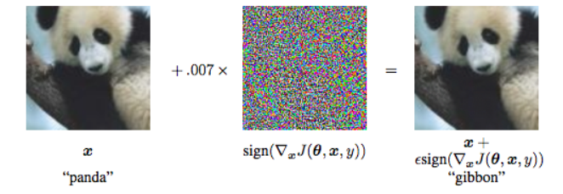

Model Evaluation (the evaluation of deep learning models )
Model Robustness
Robustness is akin to the mathematical concept of stability, which is defined as how effective a model is when tested on a slightly perturbed version of a clean input, where the outcome is supposed to be the same.
Adverserial image
it is possible to add small adversarial perturbations to input data to generate adversarial images which the model misclassifies. This technique of adding adversarial perturbations to input data is known as an adversarial attack.
we make extensive use of adversarial attacks to generate adversarial images for steganalyzers. Current research shows that adversarial images are useful as training samples and help create robust models .

Slide 18
Steganography Techniques
steganographic embedders can be categorized as (1) frequency, (2) spatial, or (3) deep learning:
Frequency :
Frequency domain steganographic embedders use statistical techniques to hide information in the frequency coefficients of an image
Spatial:
Spatial domain steganographic embedders also use statistical techniques but hide information in the raw pixel bits of an image
deep learning
deep learning steganographic embedders use deep learning architectures such as GANs to hide information in an image .
Hint:Deep learning steganographic embedders have been very effective at hiding large quantities of data while avoiding detection from state-of-the-art steganalyzers . it is important to note that every steganographic embedder has a corresponding steganographic decoder that decodes the embedded message from the steganographic image.

Slide 19
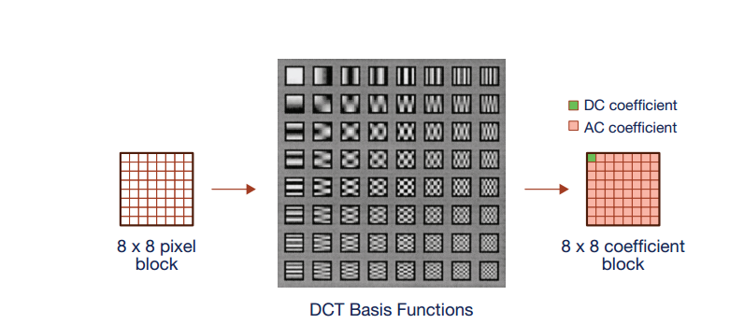
Frequency domain
The frequency domain refers to images represented by signal data, such as the JPEG image format. In this domain, raw image data (pixel values) are translated to signal data via some signal processing method (i.e. discrete cosine transform) to produce a set of signal coefficients (i.e. discrete cosine transform coefficients).

Slide 20
Frquency domain
In the frequency domain, image data is stored in quantized frequency coefficients. Frequency-domain steganography embeds message data by modifying the non-zero frequency coefficients of the image.
While spatial domain steganography operates on pixel values (the left array), frequency domain steganography operates on DCT coefficients (the right array).
Common methods in frequency-based steganography include :
F5
J_UNIWARD
EBS
UED
Hint:For the most part, these methods aim to minimize statistical distortions in the steganographic image.

Slide 21
Frquency domain
The embedding ratio of frequency domain steganography is measured in bits per non-zero AC DCT coefficient (bpnzAC) .The AC coefficients represent 63 total coefficients in each coefficient block, excluding the coefficient at [0, 0] (i.e. 239 ). Traditionally, the coefficient at [0, 0] holds the most signal in that coefficient block and is never modified. Furthermore, zero-valued coefficients are also not counted, since most steganographic embedders avoid using these coefficients.

Slide 22
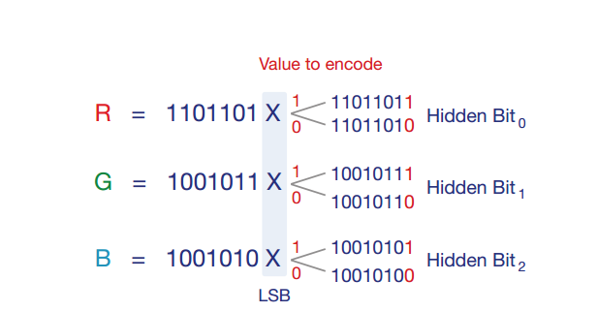
Spatial domain
The spatial domain is defined as the raw image pixels that are used to define an image. For png images, this is the RGB value used to represent each pixel. Spatial domain steganography conceals the secret information within these pixel values, usually by substituting secret bits inside them .
Least significant bit (LSB) steganography is a spatial technique that replaces the last bit of the pixel with message content. For example, if the value being encoded is a 1, the last pixel value bit is set to 1.

Slide 23
Spatial domain
Other methods include:
S UNIWARD
HUGO
WOW
HILL
These methods use sophisticated techniques that minimize image distortion to better embed data, thereby reducing the impact that the embedding operation has on the underlying source distribution of the cover image.

Slide 24
Deep learning domain
The deep learning domain refers to steganographic embedders that make use of deep learning methods to embed steganographic content. steganographic embedders use generative deep learning networks to combine an input message and cover image into a steganographic image.
Different networks used in this approach:
SteganoGAN
HiDDeN
BNet
for example below figure showed the structure of stegano gan , which makes use of a GAN architecture to generate high-quality steganographic images .

Slide 25
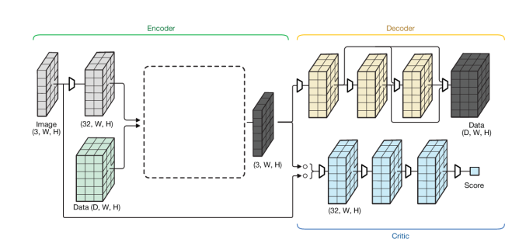
Deep learning domain
Machine learning-based steganography uses machine learning to embed data inside images. This figure shows SteganoGAN, which is a generative adversarial network that embeds messages in a highly undetectable way.

Slide 26
Steganalysis Techniques
Steganalysis is the process that detects whether a file contains steganographic content. Steganalysis procedures fall into one of two categories:
(1) statistical steganalyzers (2) deep learning steganalyzers
statistical steganalyzers :
use extensive feature engineering to exploit the fact that steganographic embedders introduce statistically significant artifacts (i.e. pixel bit values follow unnatural distributions).
deep learning steganalyzers :
use CNN architectures to learn the statistical imprints of different steganographic embedders . These methods have proven to be very effective against spatial and frequency modes of steganography .

Slide 27
Statistical Techniques
Statistical steganalyzers rely on detecting statistical abnormalities introduced via steganographic embedders. For example, LSB steganography has been shown to significantly modify an image’s natural pixel value distribution.
Statistical steganalyzers are often augmented with support-vector machines and specialized feature-engineering to pull out rich signal data from the underlying source distribution , In general, statistical steganalyzers are only effective against a limited set of spatial and frequency-based steganographic embedders .

Slide 28
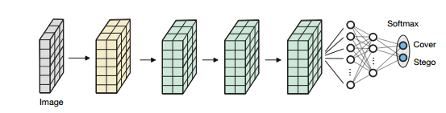
Deep Learning Techniques
Deep learning steganalyzers traditionally use CNN architectures to extract steganographic signal for example following example showed cnn model for steganalyzing.
Other methods in this way are:
YeNet
XuNet
SRNet
CISNet

Slide 29
Challenge in deep learning method
Deep learning steganalyzers depend heavily on their training dataset. even though deep learning steganalyzers have been very effective at steganographic detection, they remain relatively non-robust.
Understanding and solving these failure modes remains one of the more challenging obstacles facing deep learning steganalyzers.

Slide 30
Thanks for your consideration.

